Slide 1
Nth highest salary

Slide 2
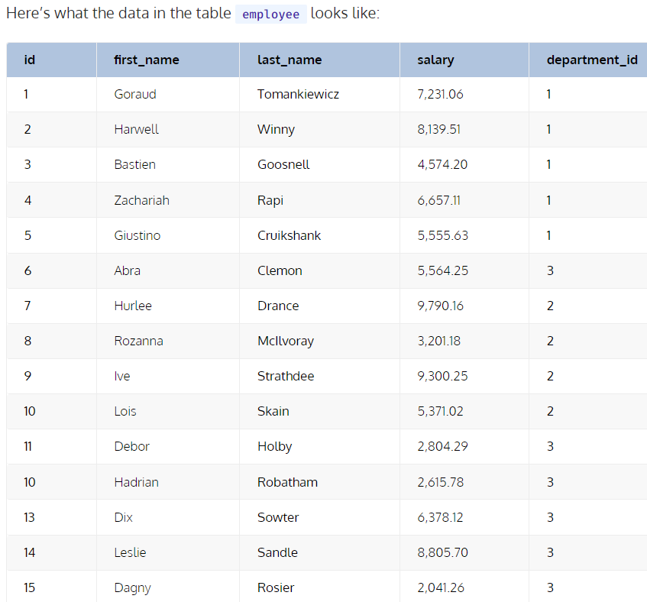
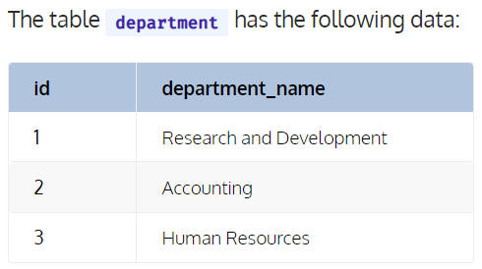

Slide 3
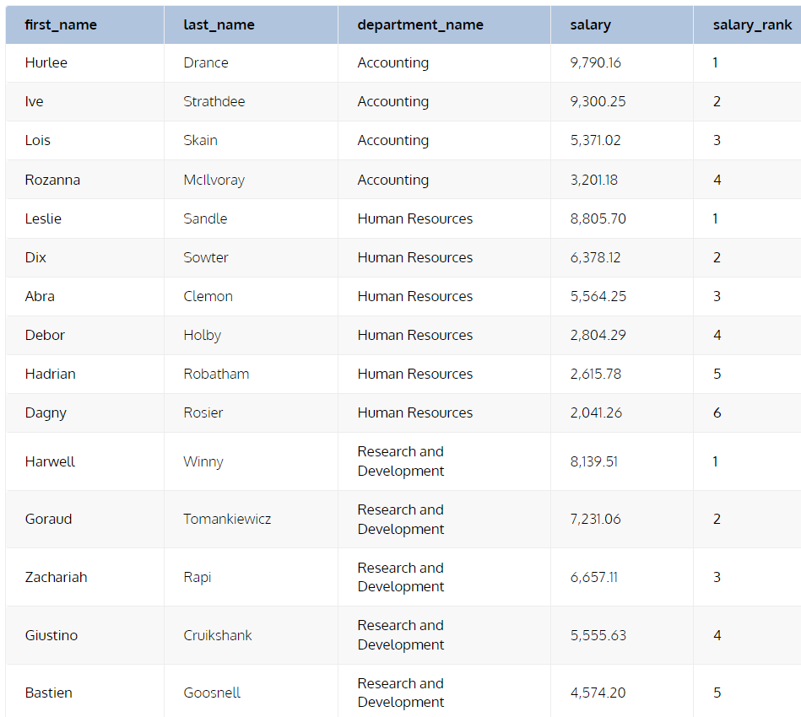

Slide 4



Slide 5
Third highest salary department wise?

Slide 6
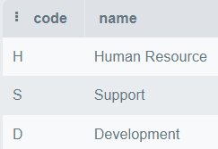
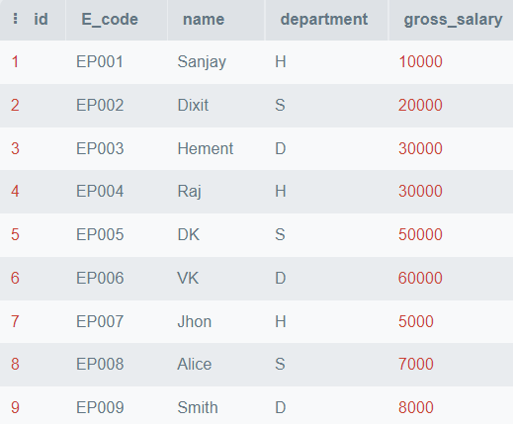


Slide 7
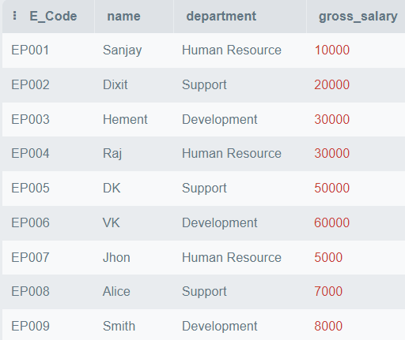
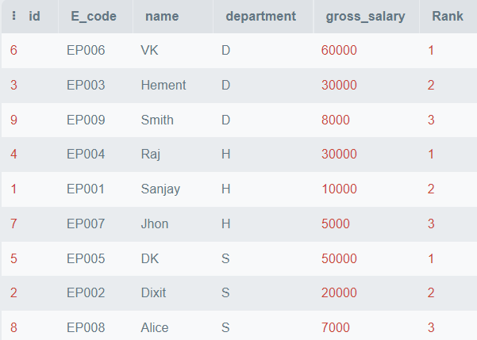

Slide 8
Find out Employees who earn more than their manager?

Slide 9
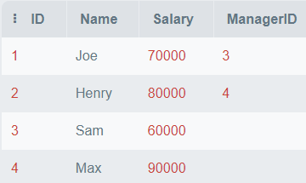



TABLE : e1
TABLE : e2

Slide 10
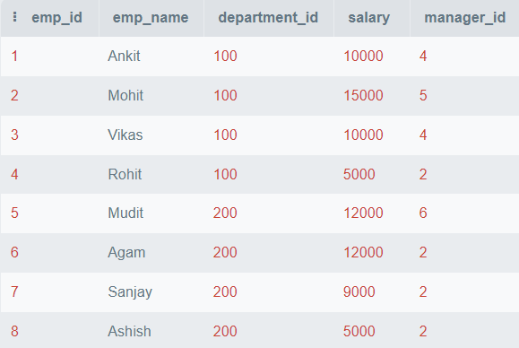
TABLE : Employee
TABLE : Manager

Slide 11
